Slide 1
Data Science Challenge: Card Transactions
Findings and Modelling

Slide 2
The Story
I was given a credit card transaction dataset
Goals:
Phase 1:
Load the dataset
Generate insights about the structure of the data
Provide summary statistics
Phase 2:
Visualize processed amounts of each transaction
Visualize other columns to generate insights
Phase 3:
Identify reversed transactions and provide a summary
Identify multi-swipe transactions and provide a summary
Phase 4:
Build predictive models to determine if a given transaction is fraudulent
Design evaluation metrics and compare performance
Explore future directions

Slide 3
Phase 1

Slide 4
Phase 1: Data Summary
The Data has 786363 rows and 29 columns
The Summaries of some of the important numeric columns are:
There were some columns with no values, so I removed them. They were:
echoBuffer
merchantCity
merchantState
merchantZip
posOnPremises
recurringAuthInd
Name | Lowest | Highest | Mean
creditLimit | 250 | 50,000 | 10,759.46
availableMoney | -1,005.63 | 50,000 | 6,250.72
transactionAmount | 0 | 2011.54 | 136.98
currentBalance | 0 | 47,498.81 | 4,508.74

Slide 5
Phase 1: Data Insights
In terms of the type of transactions:
Card Transactions: 44.87%
Non-Card Transactions: 55.23%
Columns with few Missing Values:
acqCountry – 4,562
merchantCountryCode – 724
posEntryMode – 4054
posConditionCode – 409
transactionType – 698
5,000 unique customer IDs and 2,490 unique merchant names
Data taken over 1-year period from 2016/01/01 - 2016/12/30

Slide 6
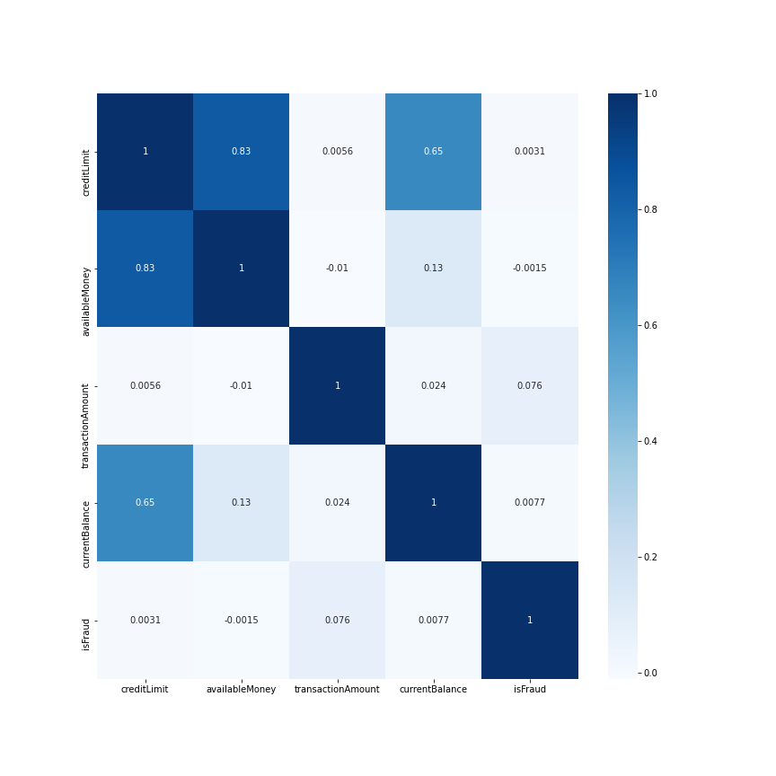
Phase 1: Data Insights
Most transactions have a credit limit of 5,000 followed by 15,000
Most transactions were in the USA
Online retail is the highest spending category followed by fast-food and entertainment
The correlation heatmap of the continuous-valued columns with isFraud ->

Slide 7
Phase 2

Slide 8
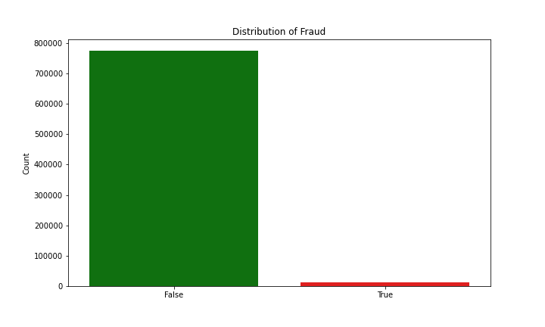
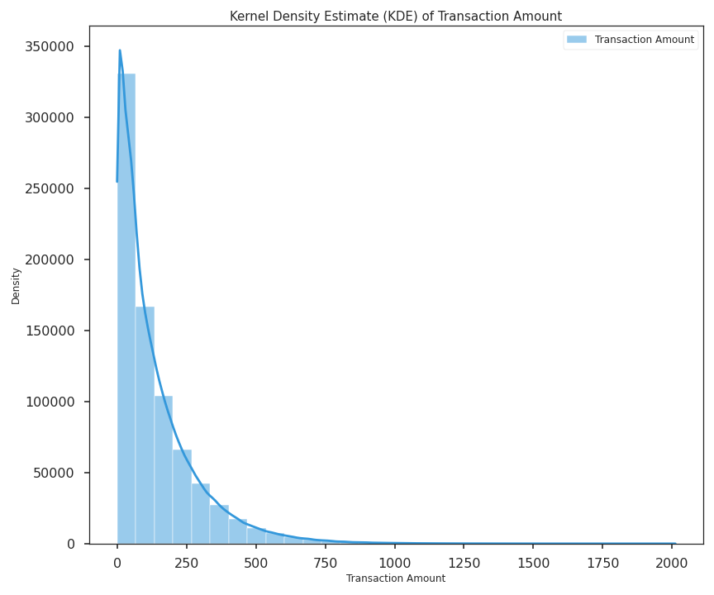
Phase 2: Visualization
Label Distribution of isFraud is:
True: 12,417
False: 773,946
About 64.03 % of instances have transaction amount <= mean and about 50% of cases have transaction amount <= median

Slide 9
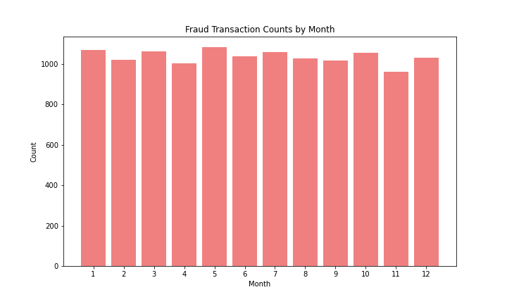
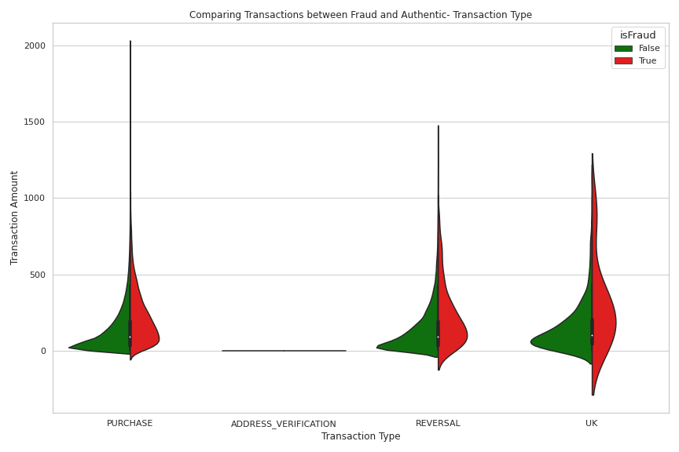
Phase 2: Visualization- Frauds
The number of frauds is consistent month-on-month with a minimum value of 959 and a maximum value of 1081
Violin plot of Transaction Amount vs Transaction Type
Frauds have higher transaction amounts
Frauds are more common in PURCHASE

Slide 10
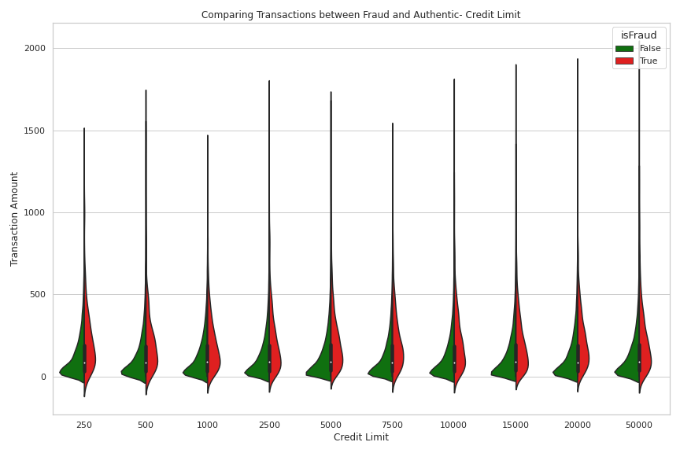
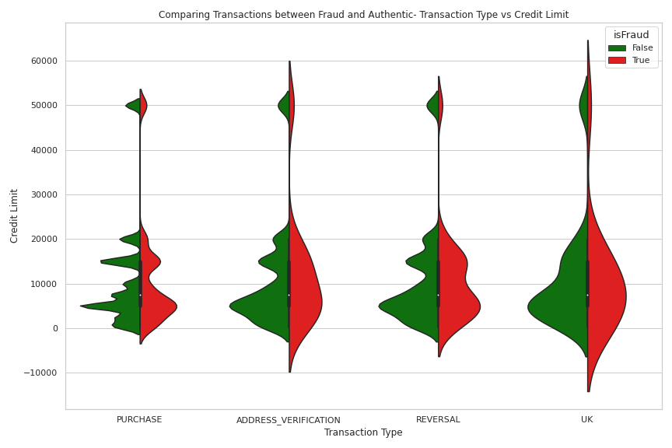
Phase 2: Misc. EDA
Violin plot of Transaction Amount vs Credit Limit
Violin plot of Credit Limit vs Transaction Type

Slide 11
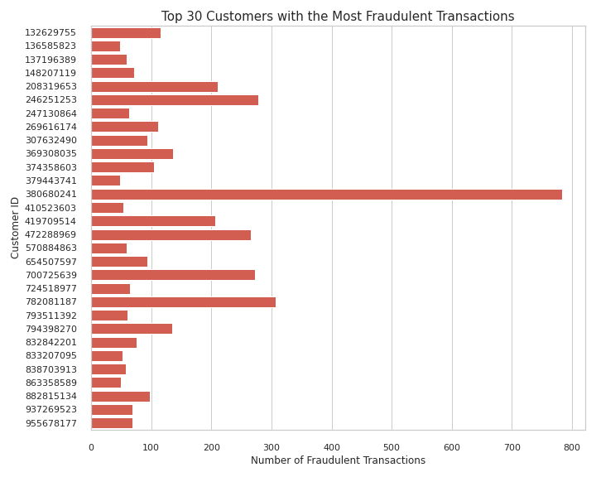
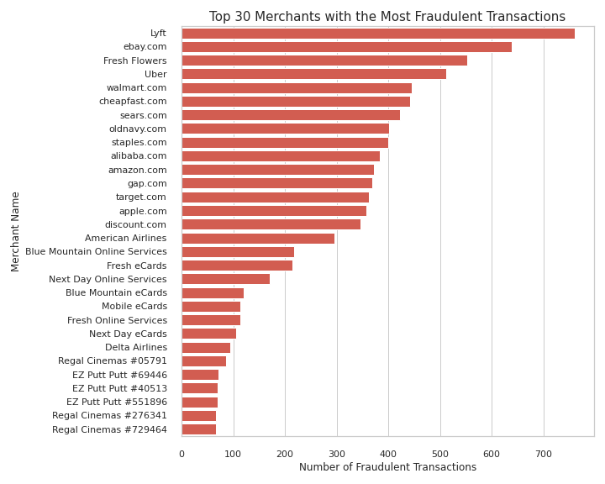
Phase 2: Misc. EDA
Top 30 Customer IDs with Most Frauds
Top 30 Merchant Names with Most Frauds

Slide 12
Phase 3

Slide 13
Phase 3: Detection of Reversed Transactions
Manually inspected some points:
All of the columns except for transactionDateTime, AvailableMoney, currentBalance and TransactionType will remain the same for a purchased transaction that is reversed
In some cases, a reversed transaction does not occur immediately
It can be assumed that:
Two PURCHASES of the same amount from the same customer to the same merchant do not follow each other

Slide 14
Method 1: Reversed Transaction Removal
Steps:
Look at pairs of transactions where all columns are the same except transactionDateTime, AvailableMoney, currentBalance, and TransactionType
TransactionType=PURCHASE should be followed by TransactionType=REVERSED
This caused a reduction in the number of cases from 786,363 to 781,748
The label imbalance changed from 62.32:1 to 61.96:1
By this method:
Number of Reversed Transactions = 4,615
Total amount of reversed transactions= $ 108,389.24

Slide 15
Method 2: Reversed Transaction Removal
Steps:
Look at pairs of transactions where just the columns customerId, transactionAmount, merchantName, acqCountry are the same
TransactionType=PURCHASE should be followed by TransactionType=REVERSED
This caused a reduction in the number of cases from 786,363 to 717,781
The label imbalance changed from 62.32:1 to 59.12:1
By this method:
Number of Reversed Transactions = 68,582
Total amount of reversed transactions= $ 5,028,227.27
Avg Time difference between PUCHASE followed by REVERSAL = 22 days, 6 hours

Slide 16
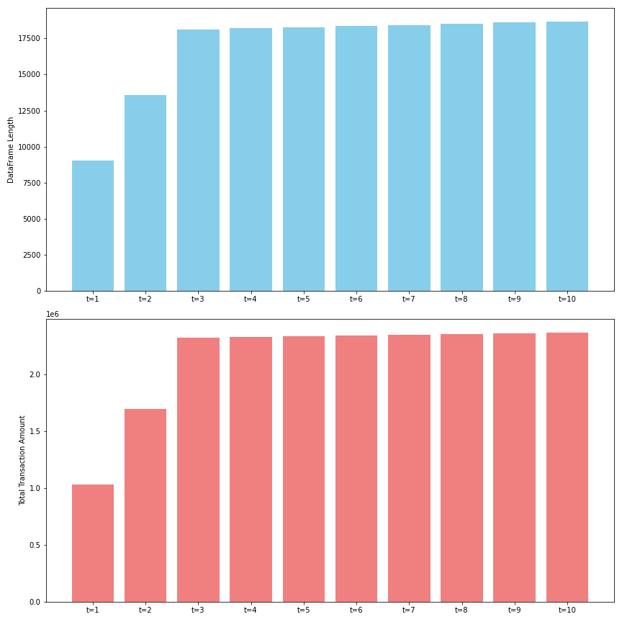
Phase 3: Detection of Multi - Swipe
Steps:
Sort the whole dataframe by CustomerID,TransactionDateTime
Use group by operation in CustomerID, MerchantName, TransactionAmount
Check if the time difference between successive Transactions is less than t seconds
Experimented on integer time delays from 1-10 minutes
Variation of the number of multi-swipe transactions (top) and total transaction amount over different time delays

Slide 17
Phase 3: Detection of Multi - Swipe
A time difference of at most 3 minutes might be the best threshold to classify a transaction as a multi-swipe transaction
This method detected:
18,105 transactions were multi-swipe
The total amount was $2,316,914.42

Slide 18
Phase 4

Slide 19
Phase 4: Creating Features
I created the following columns:
Binary valued sameCountry denoting if acqCountry and MerchantCountryCode is the same
expTime denoting the duration (in days) between the expiry date of the count and the transaction date
openTime denoting the duration (in days) between the transaction date and the account opening date
changeaddTime denoting the duration (in days) between the transaction date and the date of address change
LabelEncoder for merchantName
Boolean values for:
cardPresent
expirationDateKeyInMatch

Slide 20
Phase 4: Creating Features
Performed one-hot encoding of the columns:
creditLimit
posEntryMode
posConditionCode
merchantCategoryCode
transactionType
Normalized the other continuous columns with a z-score normalizer
Evaluated the performance of the following models:
Decision Tree (DT)
Random Forest Classifier (RF)
Feed- Forward Network (FFN)
I used the following models as the DT will be able to help us construct rules to filter the feature columns for our task. Simularly, RF is a better variant of DT which will not be influenced by outliers. A 2 layer FFN was considered because it will be able to detect patterns in the data instances in higher dimensions

Slide 21
Phase 4: Experiments
Procedure:
Split the overall data to train and test with an 80:20 split
Performed hyperparameter tuning for 5-fold cross-validation of the train data
Evaluated model performance for test instance
Using any undersampling/ oversampling technique will not be good as real data will not have labels, and a model trained on undersampled/oversampled data will never do well with real data.
Evaluation Metric:
As the label imbalance is very high, the model can easily learn to predict the majority class
So, accuracy is not a good metric
Instead, Area Under Curve (AUC) is a better evaluation metric

Slide 22
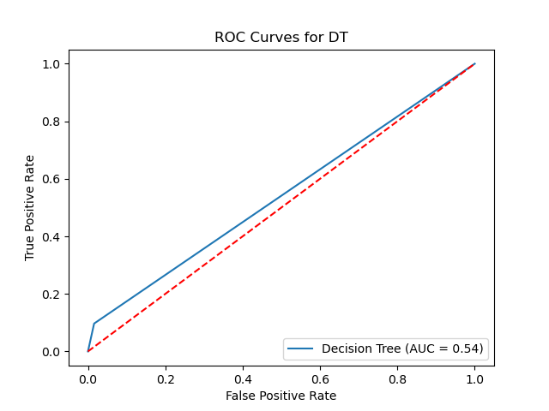
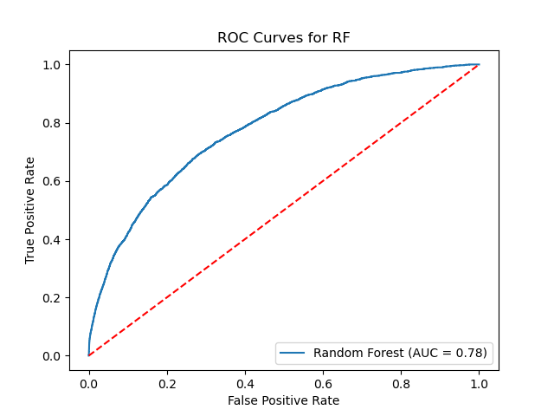
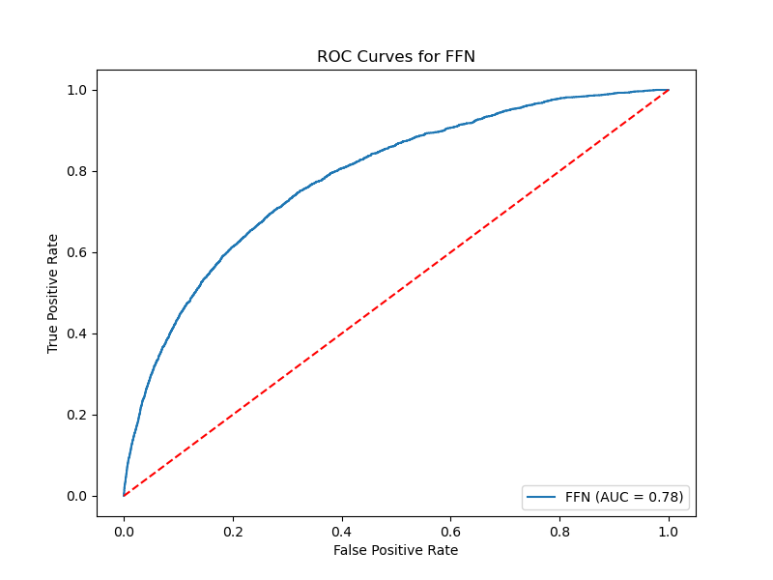
Phase 4: Results
Model | Test AUC
Decision Tree | 0.546
Random Forest | 0.782
Feed Forward Network | 0.784
We trained the FFN for 100 epochs
Although FFN performed best in terms of test AUC, the performance of Random Forest is commendable

Slide 23
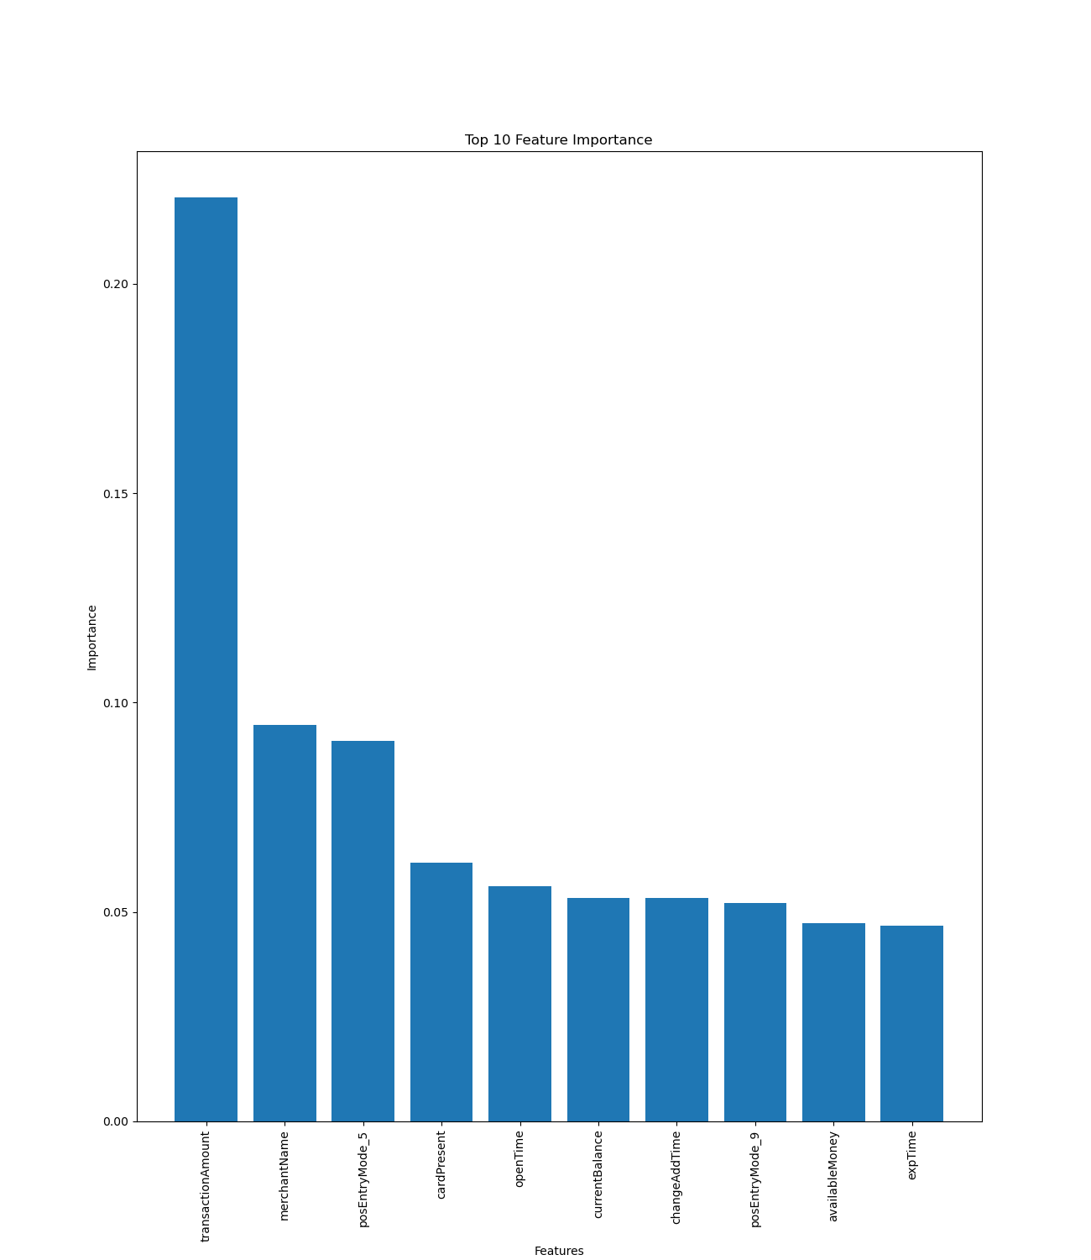
Phase 4: Discussion
Exploring the predictions of the Random Forest model further:
Most important feature is transactionAmount
Other important features in descending order are merchantname, posEntryMode=5, cardPresent, opentime
This means that transactionAmount is the most important indicator for detecting frauds
This validates a pattern I had noticed during EDA where frauds have higher transaction amounts

Slide 24
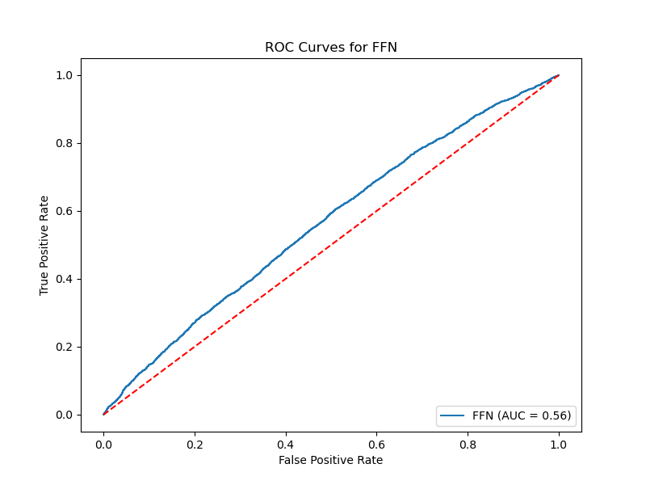
Phase 4: Alternate Direction
I also tried to improve the performance of the FFN by leveraging the use of libAUC ^{[1]}, which uses X-risk minimization for AUC maximization
The results were really poor as the test AUC was 0.564

Slide 25
Phase 4: Future Direction
If I had more time, I wanted to explore the following directions:
Explore more versions of libAUC
Exploring temporal dependencies with RNN/LSTM/GRU
Use unsupervised dynamic feature construction methods like JODIE^{[1]} where:
We represent the interaction tuple as customerID, merchantName from the data
We can make 30 minute intervals as a timestamp by using (transactionDateTime- 2016/01/01 0:00:00)
We could then evaluate the quality of embeddings by joining them with the table (customerID, timestamp,isFraud)

